Slide 1
Rendezvous in LEO
Chaser/Target relative motion animations

Slide 2
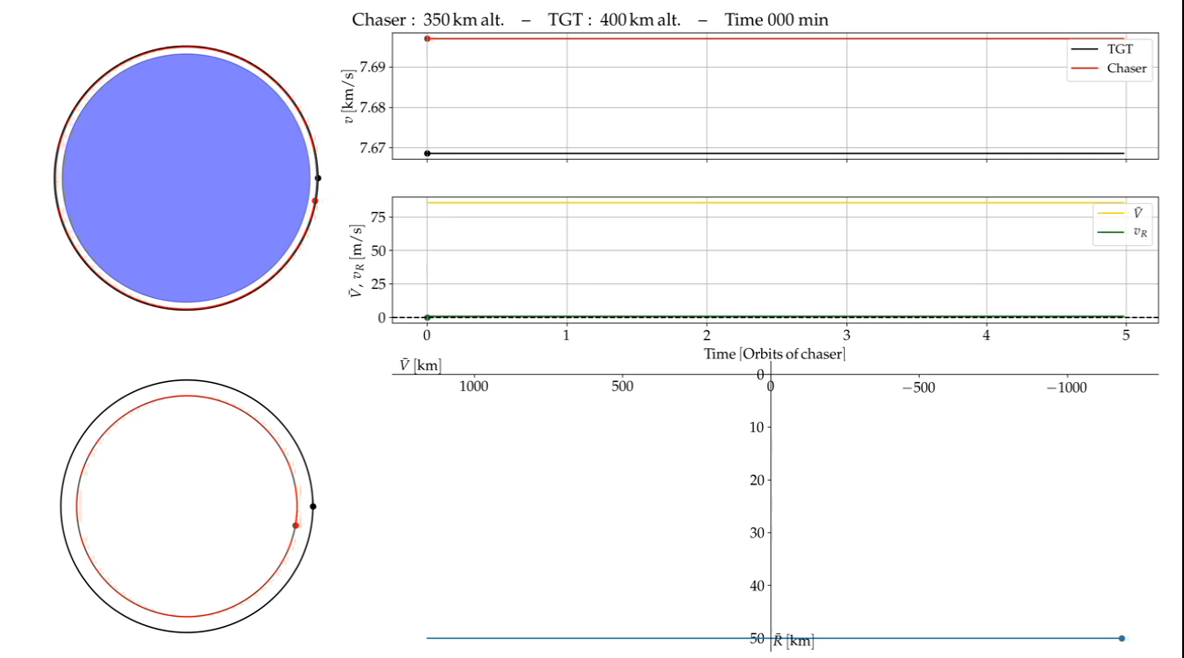
Oral exam 2019
Inertial velocities
Relative velocities Chaser/TGT
Horizontal (yellow) Vertical (green)
64

Slide 3
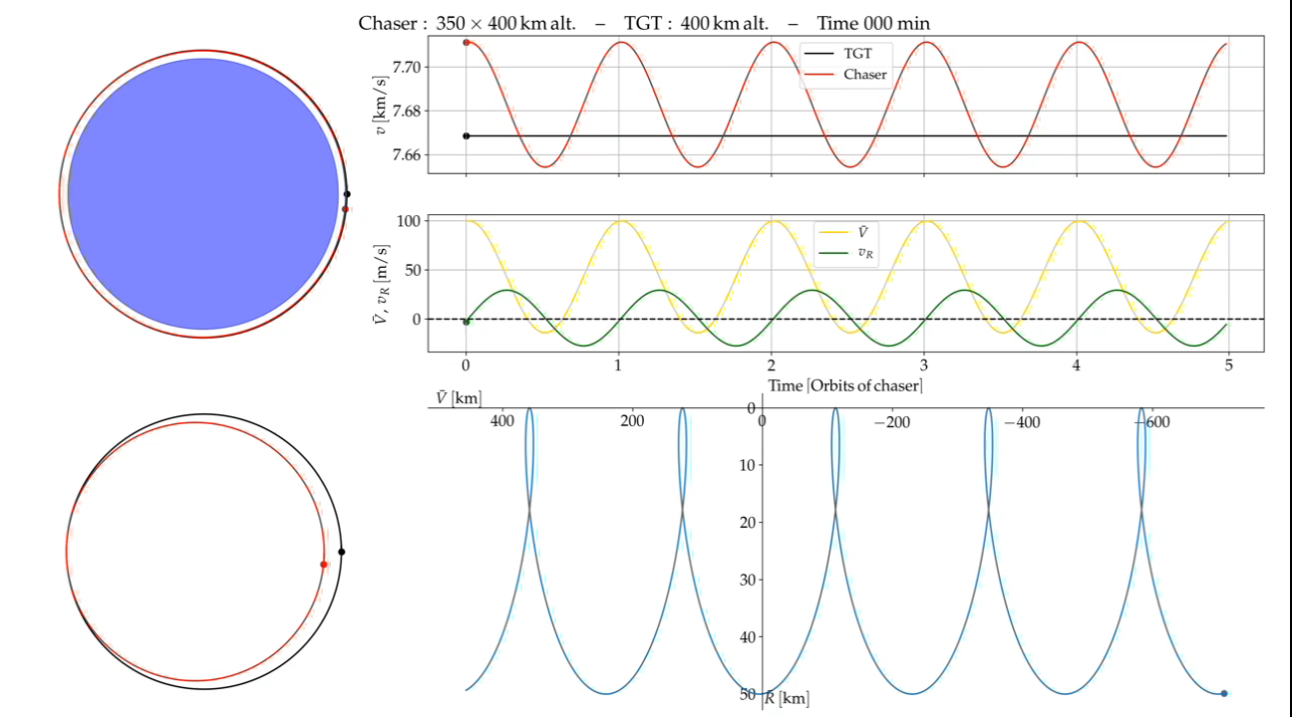
Oral exam 2019
Inertial velocities
Relative velocities Chaser/TGT
Horizontal (yellow) Vertical (green)
65

Slide 4
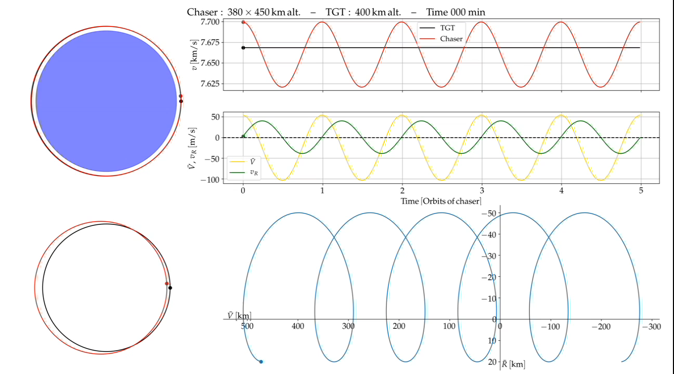
Oral exam 2019
Inertial velocities
Relative velocities Chaser/TGT
Horizontal (yellow) Vertical (green)
66

Slide 5
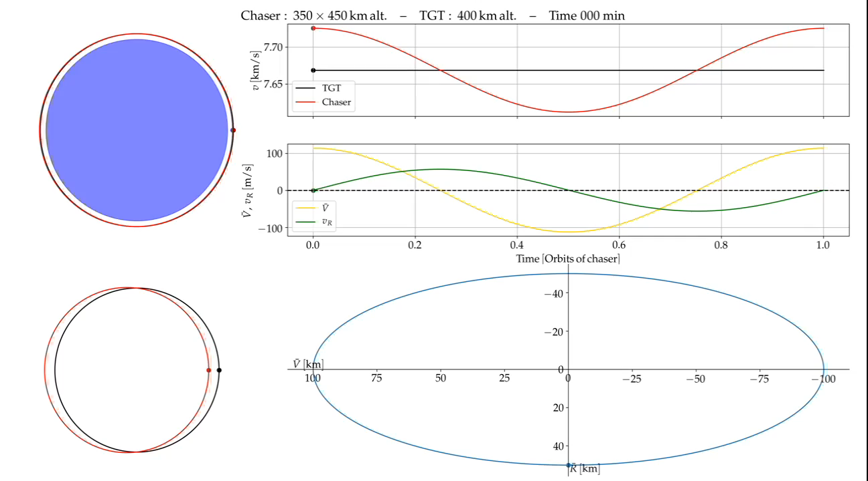
Oral exam 2019
Inertial velocities
Relative velocities Chaser/TGT
Horizontal (yellow) Vertical (green)
67

